Slide 1
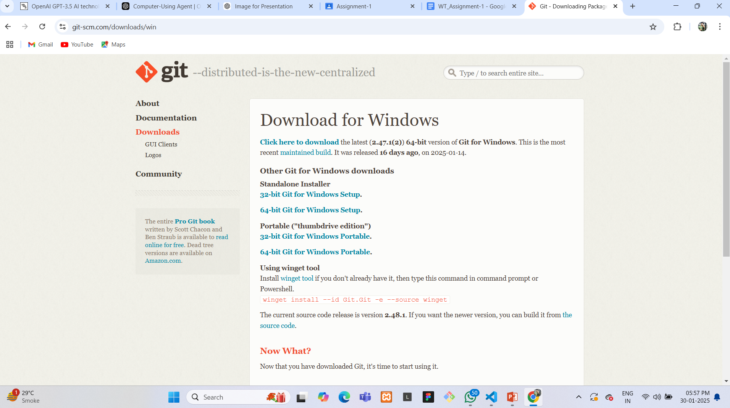
Step-by-Step Guide to Creating a Git Repository
Step 1: Install Git (If Not Already Installed)
1.Download Git from https://git-scm.com/.
2. Install Git by following the setup instructions for your operating system.
I

Slide 2
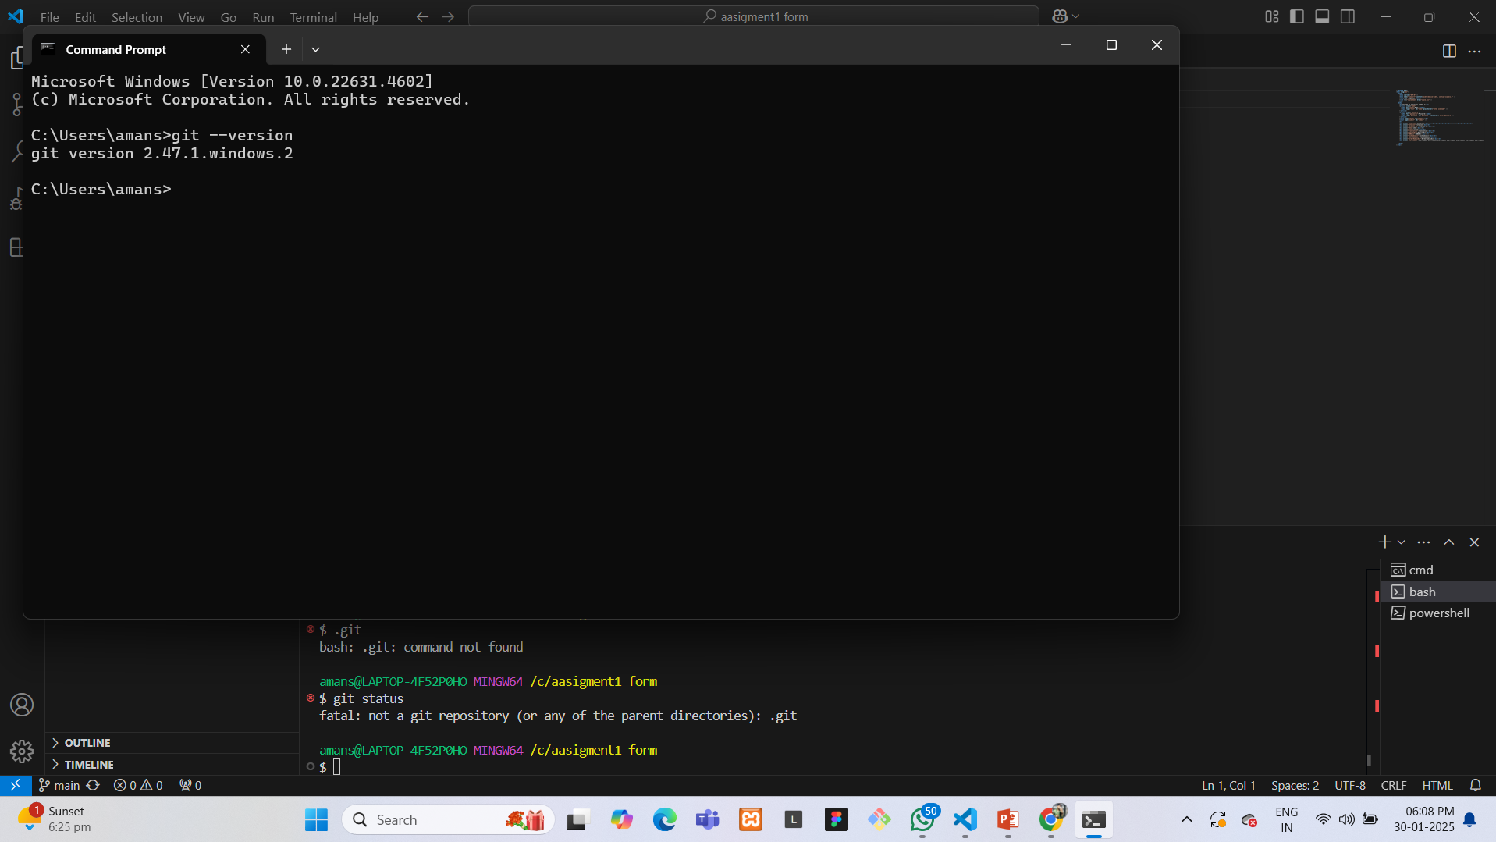
3.Verify install git by following the setup instructions for your operating system.erminal or command prompt and running:
git --version

Slide 3
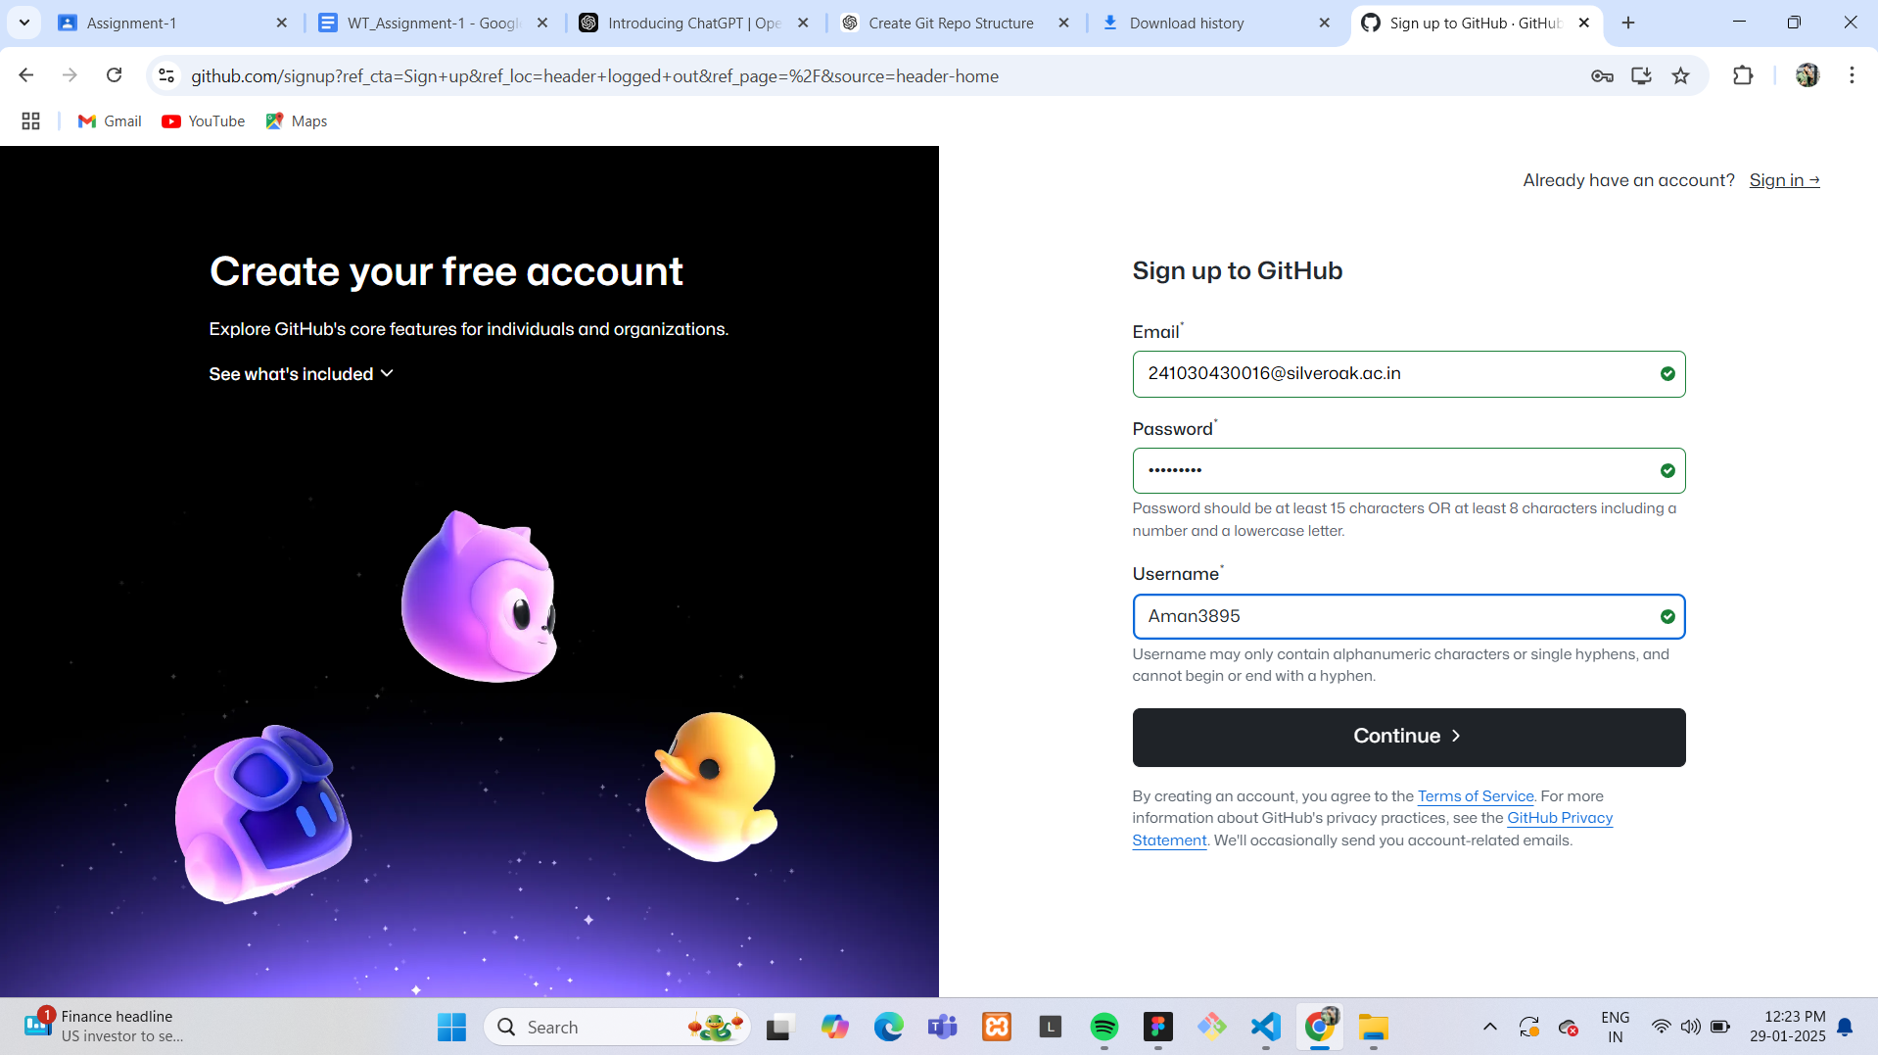
Now create an account on GitHub:
Step 1: Go to GitHub Open your web browser and go to GitHub’s official website. Click on the "Sign up" button at the top right corner

Slide 4
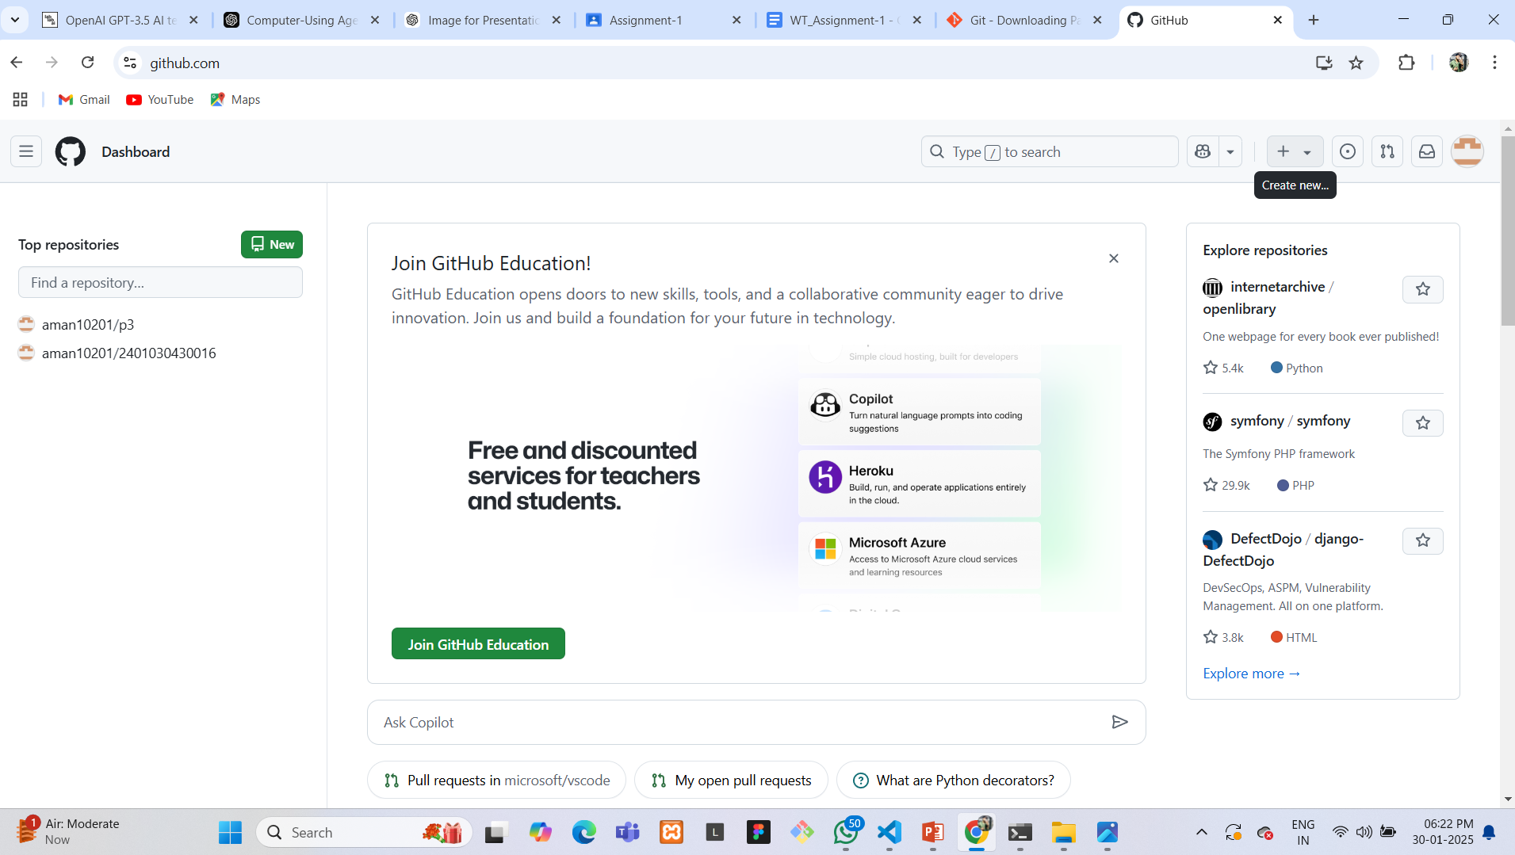
Create a GitHub Repository :
Click on the + icon at the top right and select New repository.

Slide 5
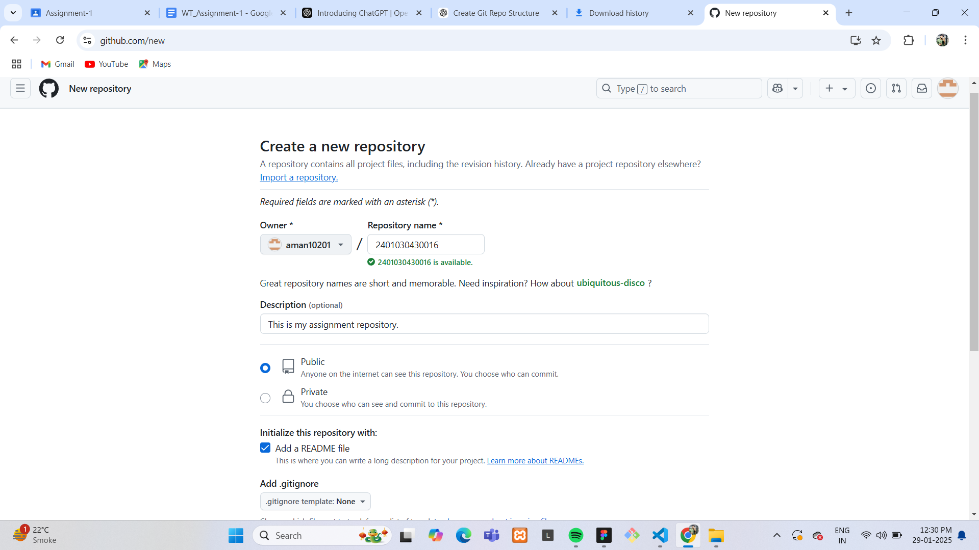
Name there pository as your enrollment number
Choose Public or Private, based on your preference.
Check Add a README file (optional but recommended).
Click Create repository.

Slide 6
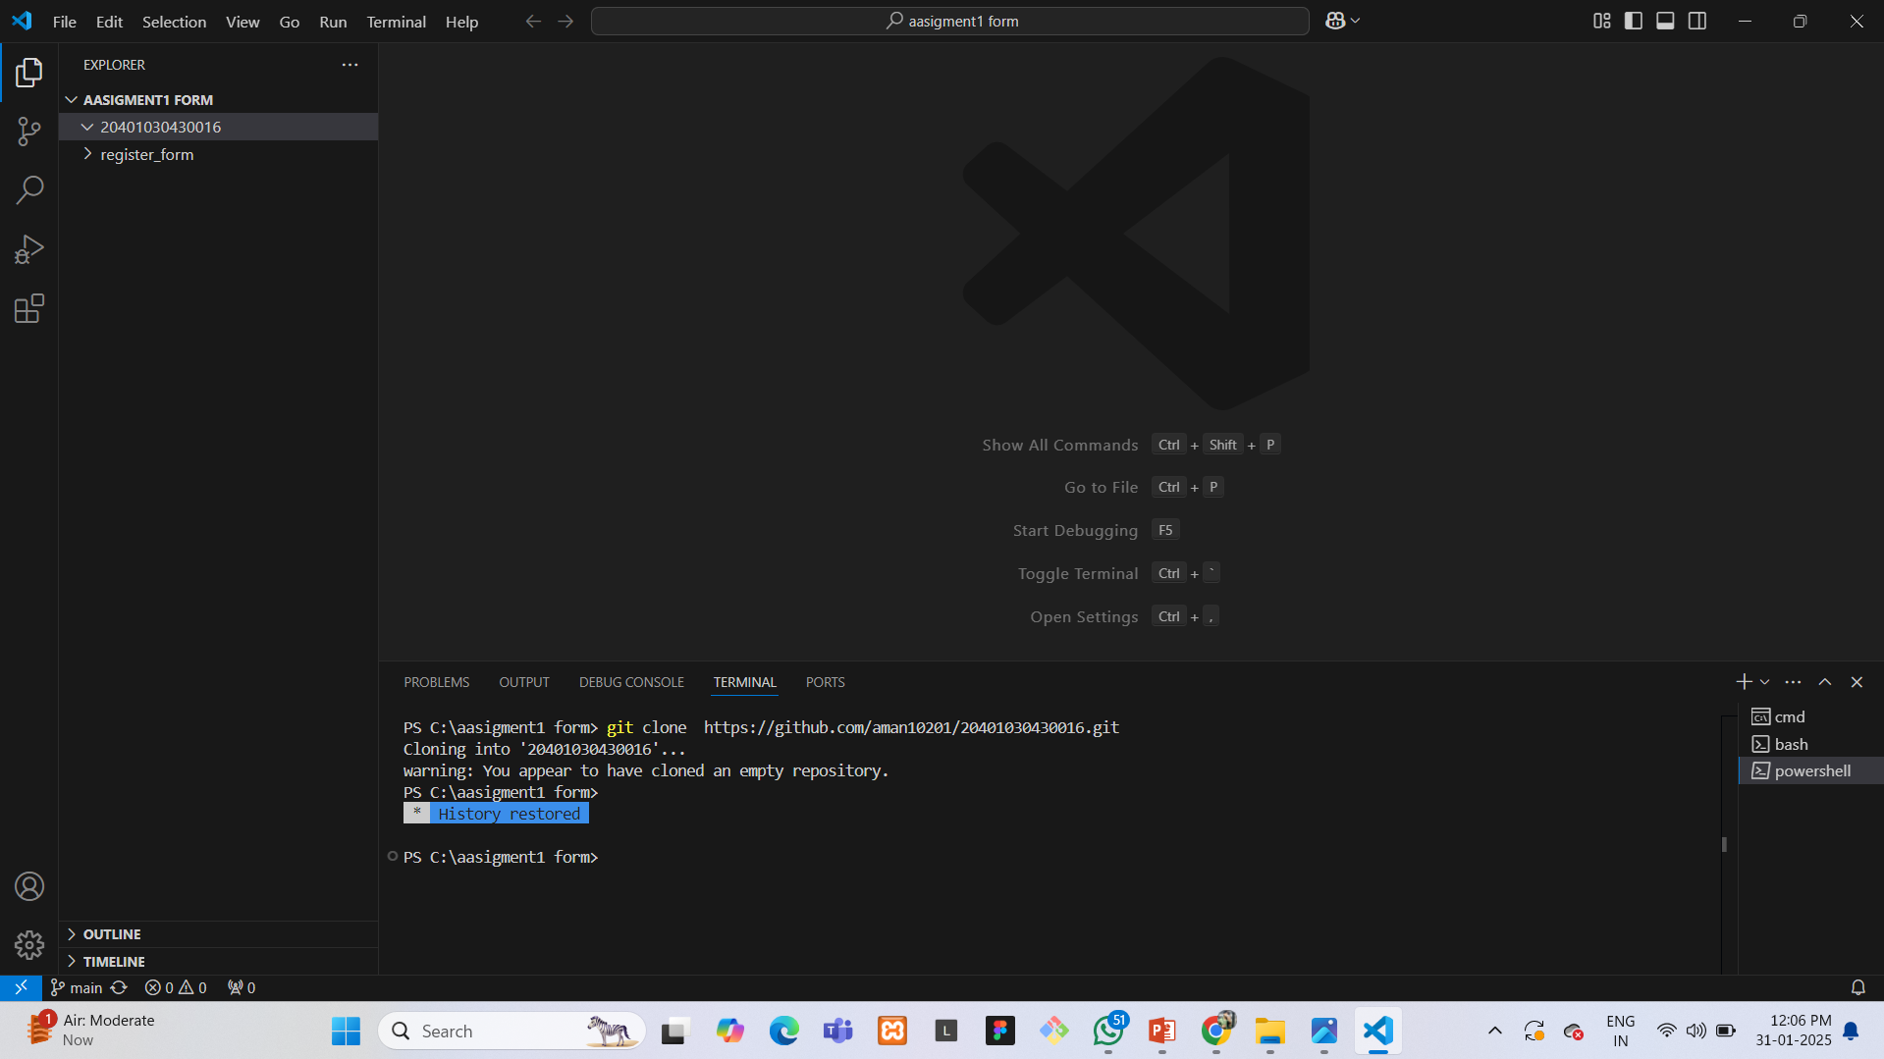
Clone the Repository to vs code :-
Copy the repository URL from GitHub.
Open your terminal or command prompt and run:
git clone <repository_url>

Slide 7
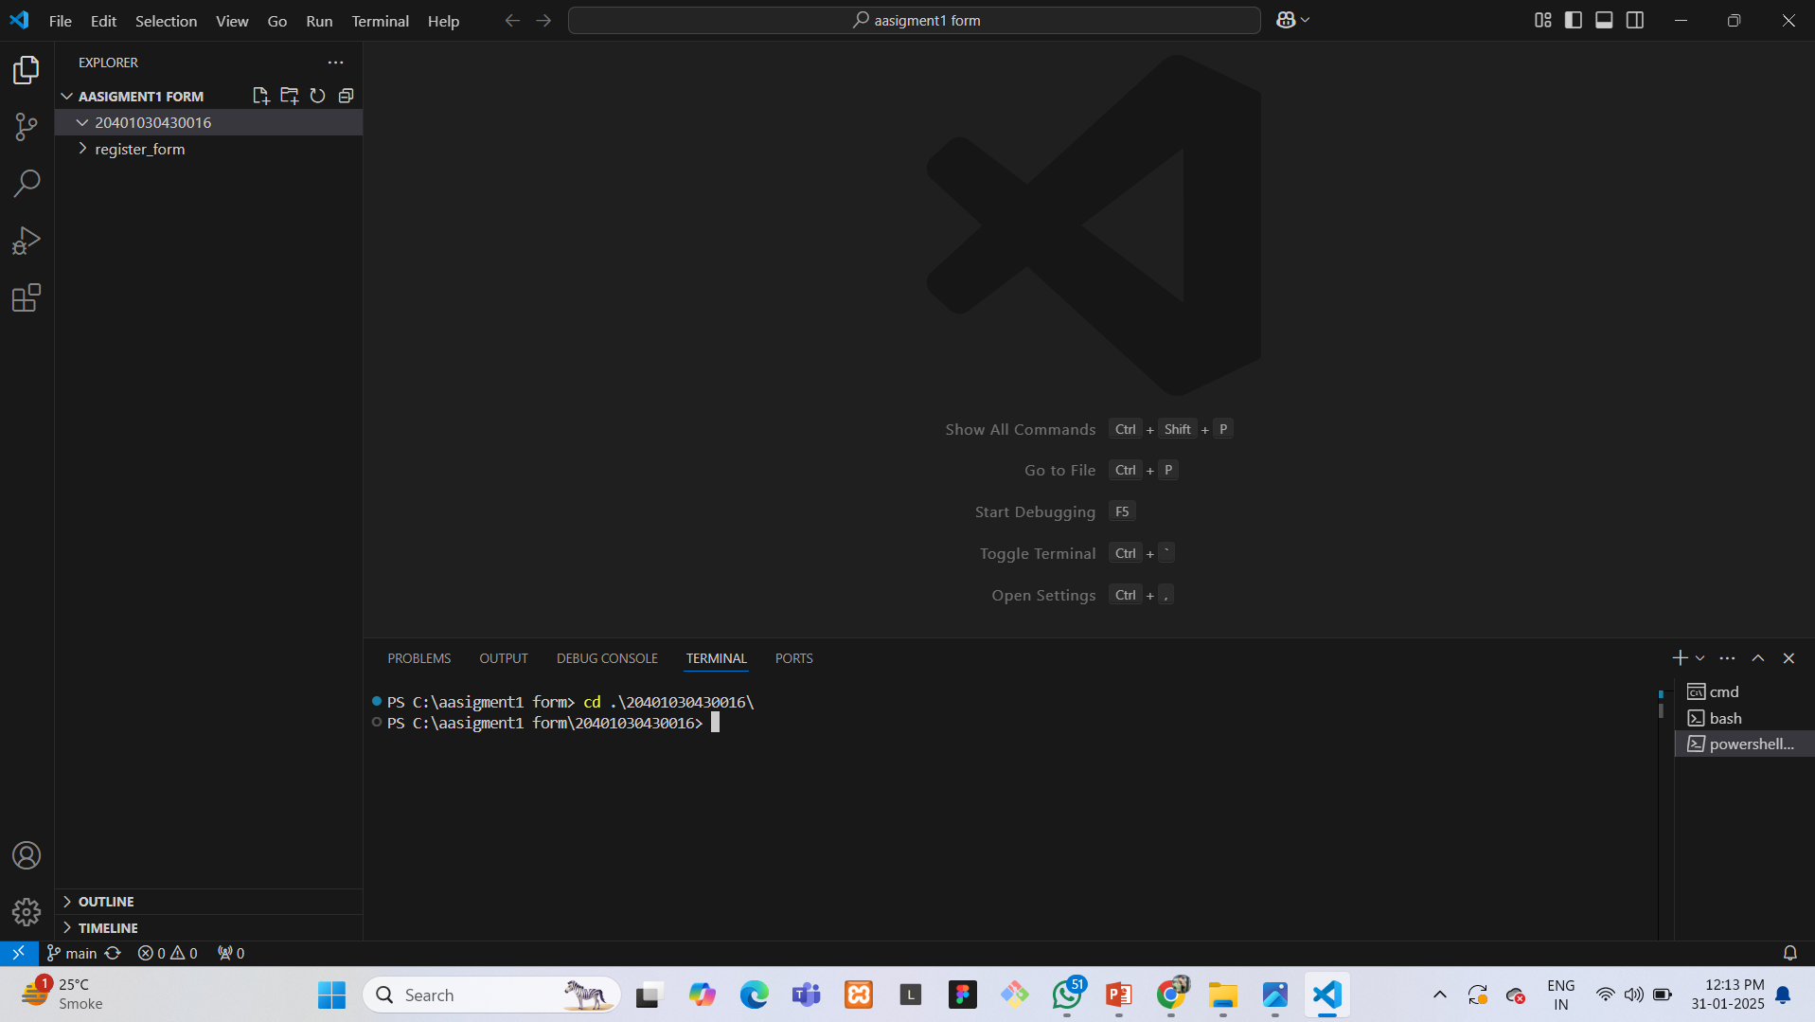
Navigate to the cloned directory:
cd <your-enrollment-number>

Slide 8
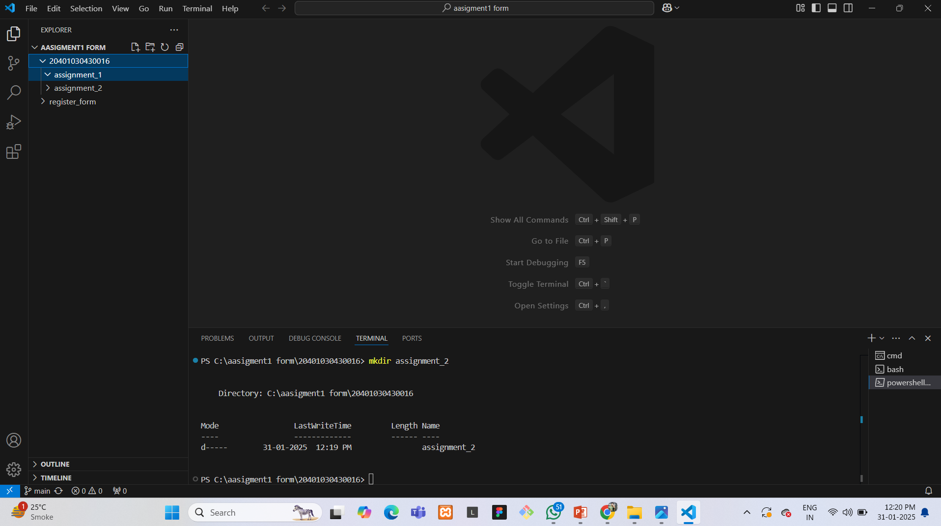
Create Folders for Assignments :
Inside the cloned repository, create two folders:
mkdir Assignment_1 Assignment_2

Slide 9
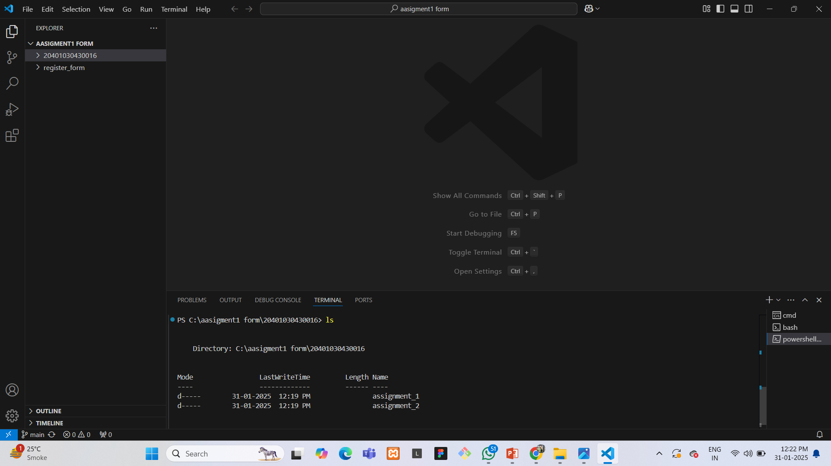
Verify the folders were created:
ls

Slide 10
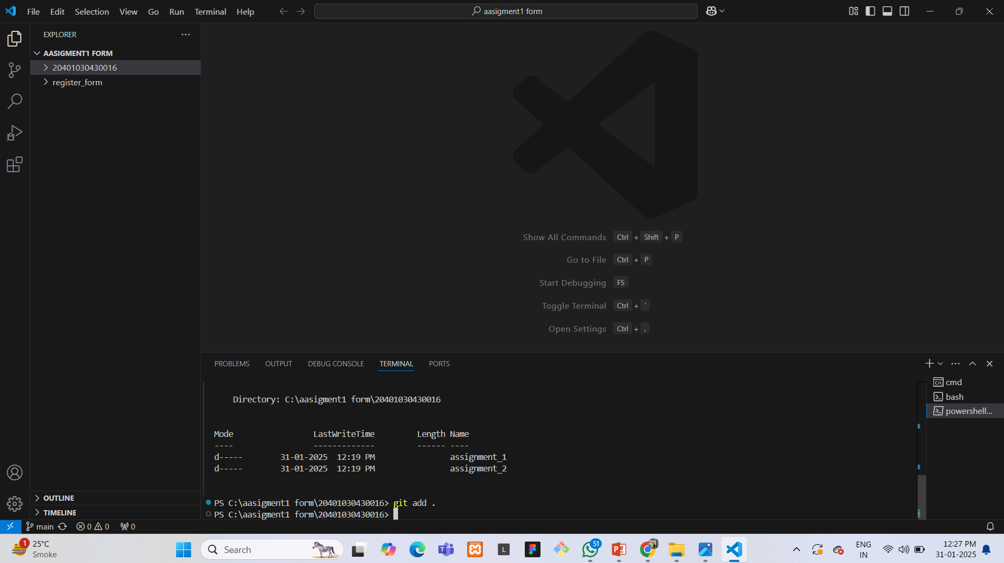
Commit and Push Changes :
Add the new folders to the repository:
git add .

Slide 11
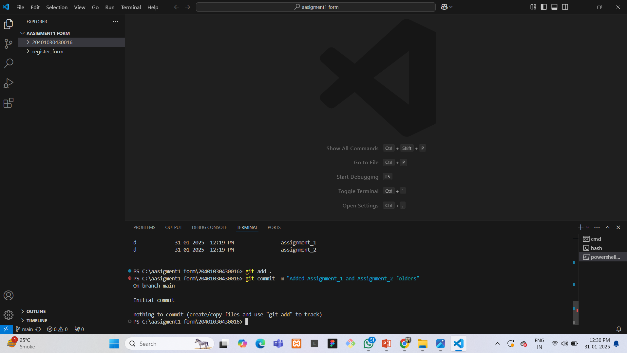
Commit the changes with a message:
git commit -m "Added Assignment_1 and Assignment_2 folders"

Slide 12
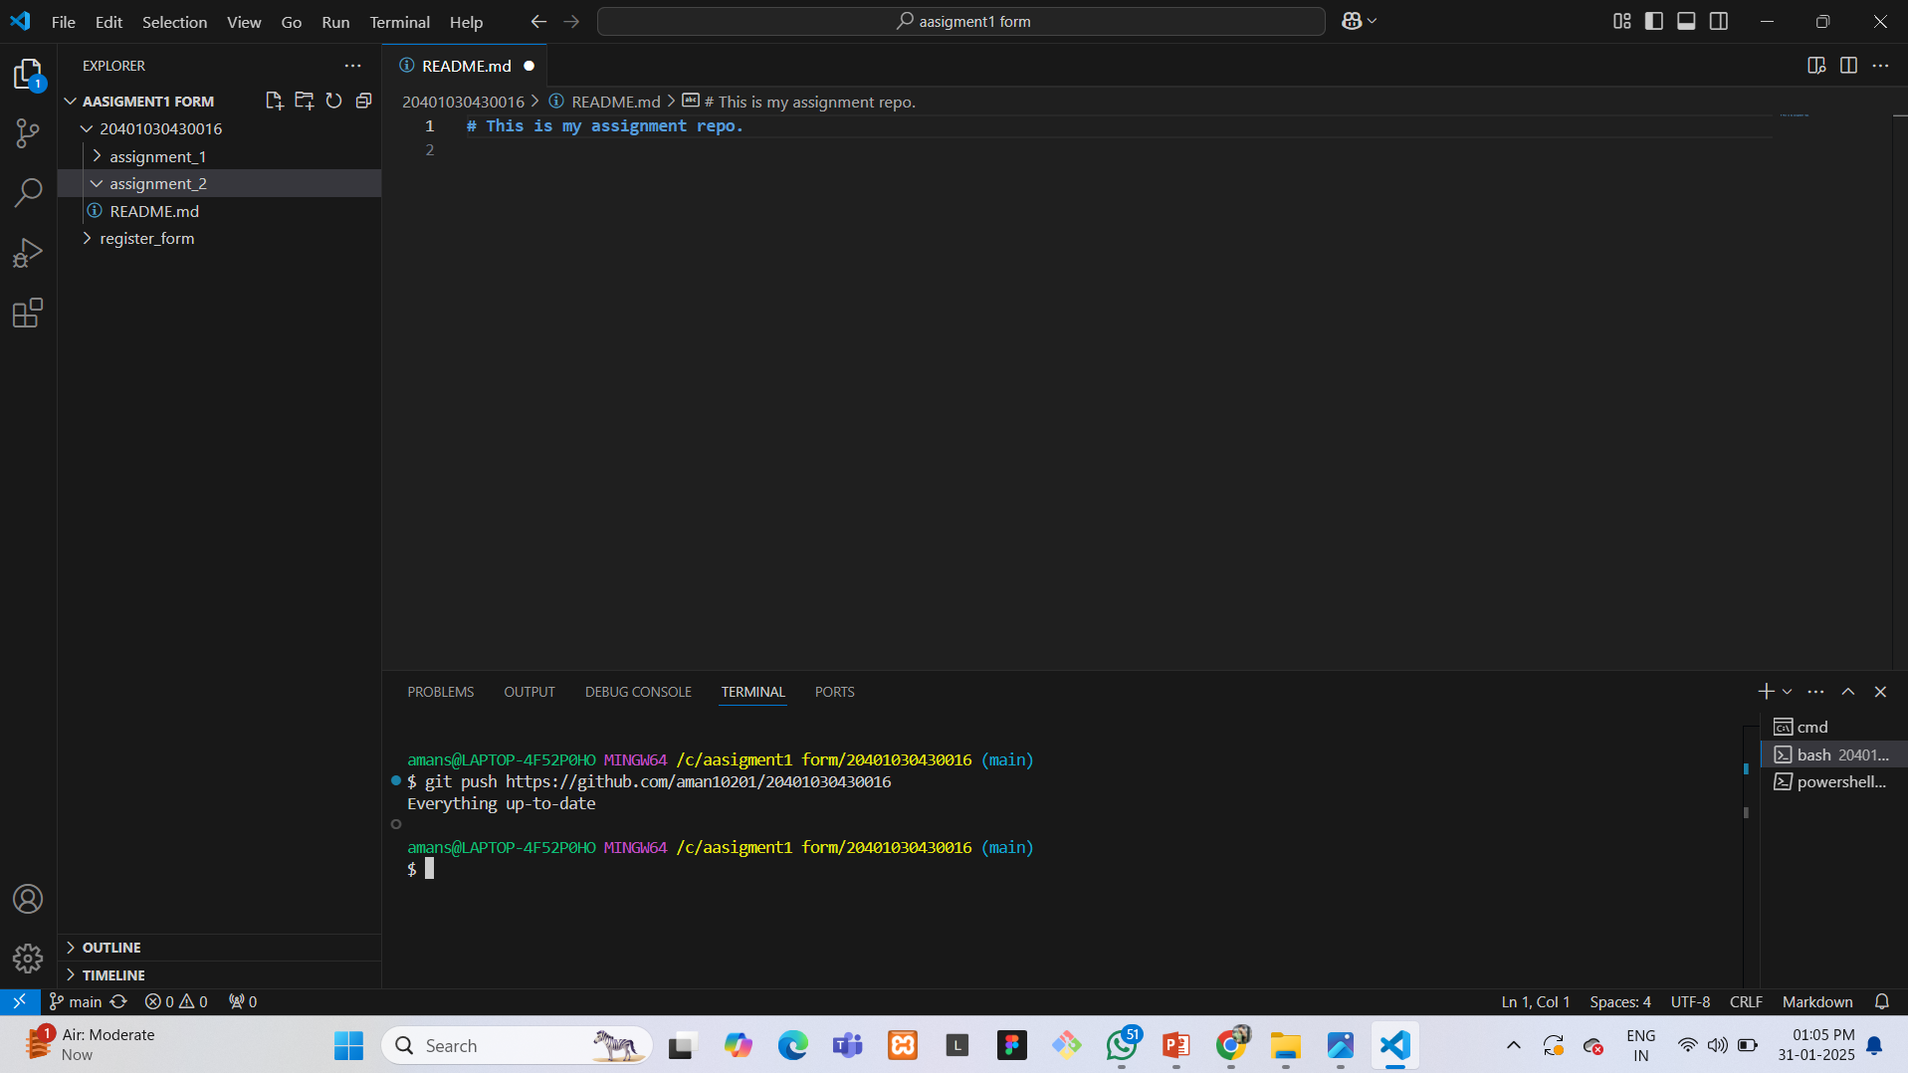
Push the changes to GitHub:
git push origin main

Slide 13
